Slide 1
Welcome to Coventry

Slide 2
Hello and welcome to the City of Coventry
In what currently stands as the 9th largest city in England you will find everything from a rich and diverse history to a rapid modernisation that has built Coventry a strong and resilient reputation.
We do hope you enjoy your time here with us, but to start with let us take you on a journey through time and show you just how much history stands between then and our present day.

Slide 3
Coventry then
Although Coventry’s official recorded history dates back to 1016 A.D. there is evidence that it dates back to the Roman ages proven by the preserved Lunt Roman Fort just outside of the city.
Coventry then grew to an established Medieval City with its infamous Six Gates; Hill, Priory, Bishop, Spon, Mill, Little Park and Greyfriars. Some of which have sections that still stand today.
In the next few centuries emerged one of Coventry’s most legendary figures; Lady Godiva who famously rode unclothed on horseback through to city to stand up to the oppressive taxations imposed by her husband Leofric the Earl of Mercia.
Between the 18th and 19th century Coventry had a massive industrial expansion with products ranging from watches to bicycles to automobiles.
During the Second World War industrial businesses were used as part of the war effort to manufacture tanks and planes for the British Armed Forces. On the 14th November 1940 the city was devastated by a series of bombings by the Luftwaffe, the bombings destroyed many buildings, perhaps most famously the Coventry Cathedral.
Though it is from this event that perhaps the city gained its most predominant symbol; the Phoenix. The bird that rose from the ashes of the Cathedral fire as a figure of hope to lead Coventry to a new and brighter beginning.

Slide 4
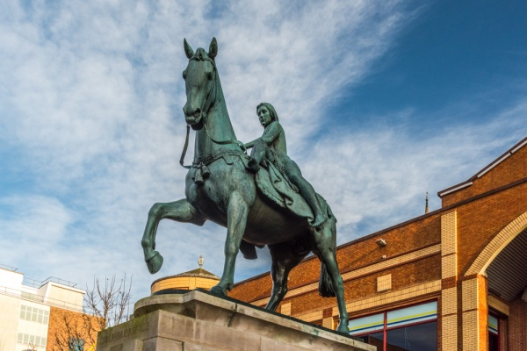
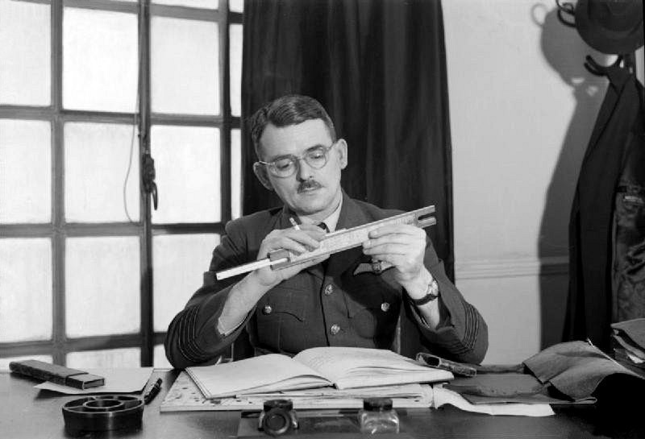
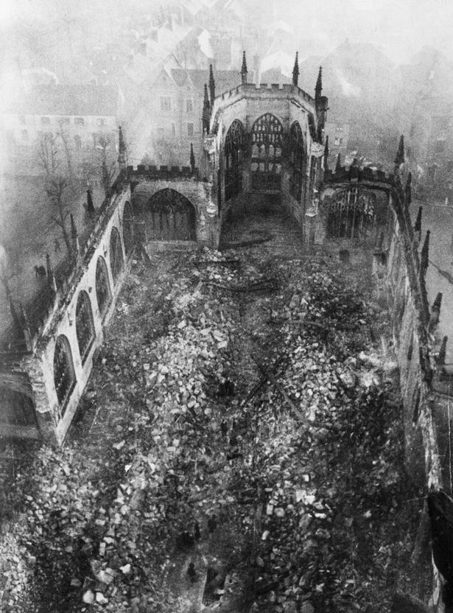
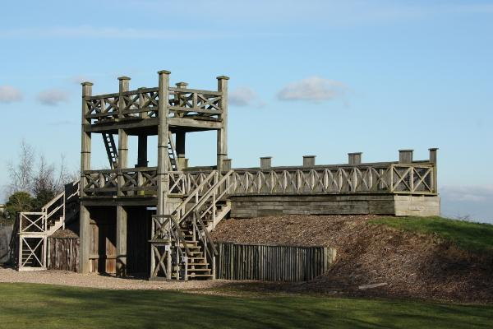
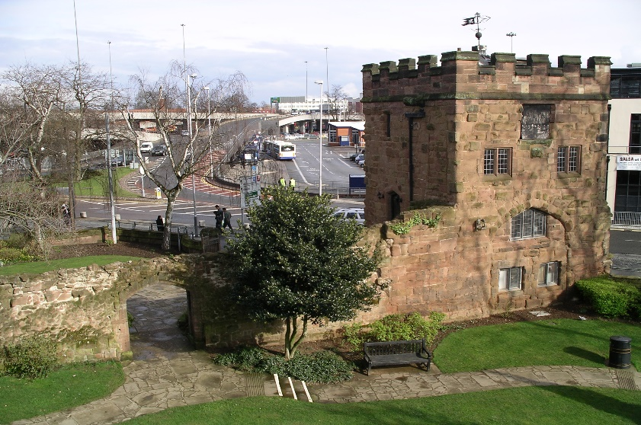
RAF Air Commodore Sir Frank Whittle. Born in Coventry and creator of the worlds first Turbojet Engine
Lady Godiva Memorial Statue
Remains of Coventry Cathedral following the Luftwaffe air raids, known today as “the Blitz”
Lunt Roman Fort
Section of Priory Wall

Slide 5
Coventry now
These days Coventry is home to a wide range of attractions that suit a variety of tastes, the remains of the old cathedral still stand to this day as a reminder of the city’s past. Next to it is the new cathedral of St. Michael constructed in 1962.
If you are a keen history buff the Transport Museum that details Coventry’s history in the manufacturing trade is a must see, or if you are a connoisseur of the arts be sure to visit the Herbert Art Gallery or take in a performance and the famed Belgrade Theatre.
Just outside the city is the now historically preserved War Memorial Park, perfect for a nice walk in the sun and a chance to take in a bit of history without having to travel to far out. Every year since 1998 the park is host to the three day Godiva Festival, the largest free music festival in the country.
As of this year (2019) a new series of restaurants were opened near the top end of the City, restaurants such as The Botanist, Las Iguanas, Cosy Club, Bistro Pierre and Zizzi’s cater to a multitude of international dishes such as Italian, Mexican, Japanese and traditional English.
In 2017 Coventry was officially named UK City of Culture 2021, as such in the run up to 2021 there are lots of cultural events taking place around the city.

Slide 6
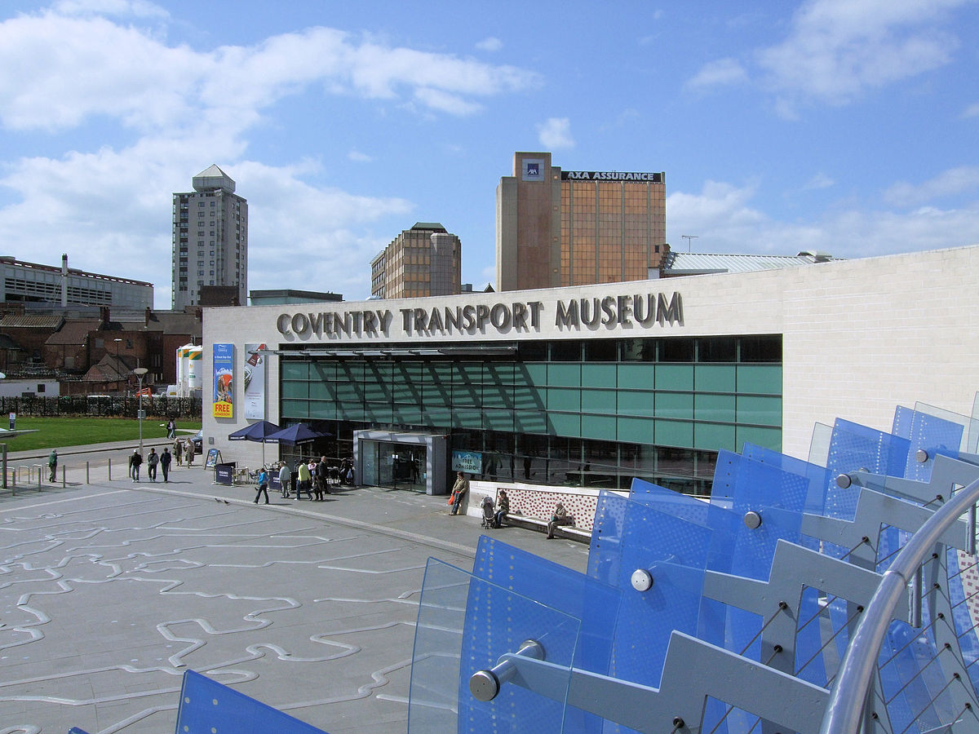
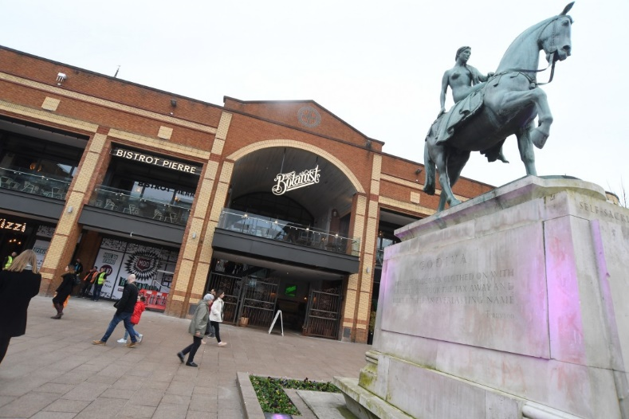
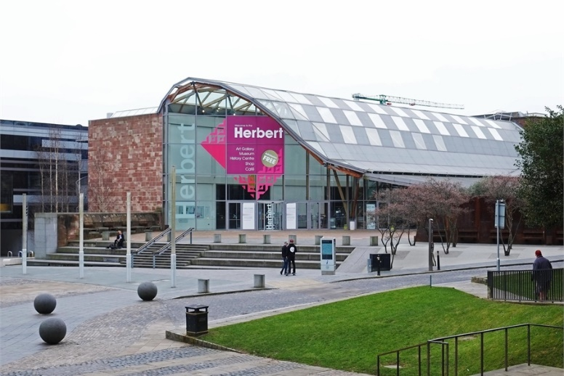
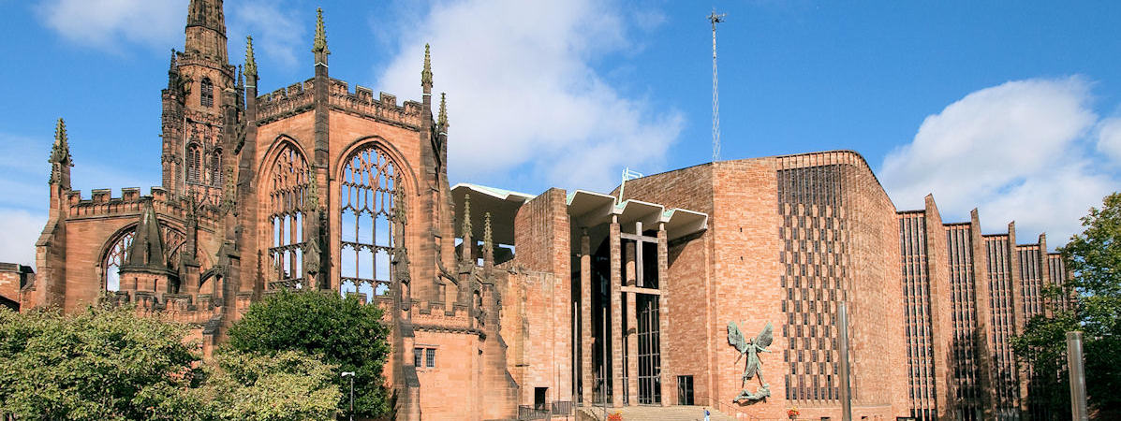
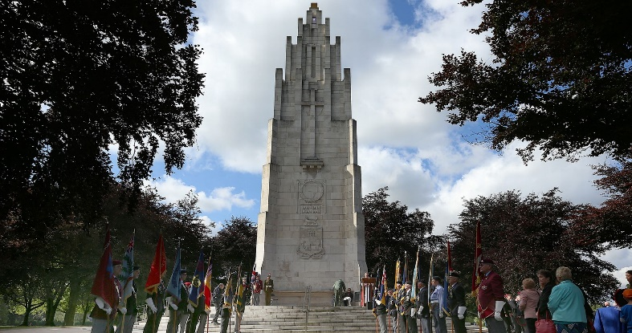
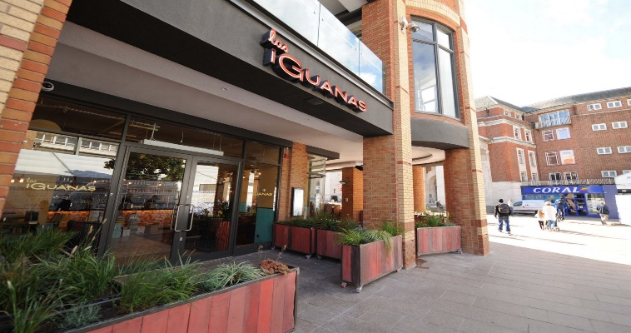

Slide 7
Coventry University
Founded in 1970 as Lanchester Polytechnic and granted university status in 1992, Coventry University is the centrepiece for the city’s culture, stability and expansion. The very logo for the university itself is inspired by the mythical Phoenix rising from the ashes of the cathedral fire, echoing the universities message for the need to move forward but at the same time to not forget where we came from.
With thousands of students joining each year from both the UK and abroad (29’000 in 2017 alone), Coventry University has become a more popular destination for hopeful and enthusiastic students. This is down to a massive improvement in our facilities as well as our student services.
Each of our faculty buildings are named after a significant figure to the region (be that cultural, industrial, political etc.)
This year (2019) saw the Guardian University Guide rank Coventry University 13th best in the country, beating the likes of Leeds and Birmingham University.

Slide 8
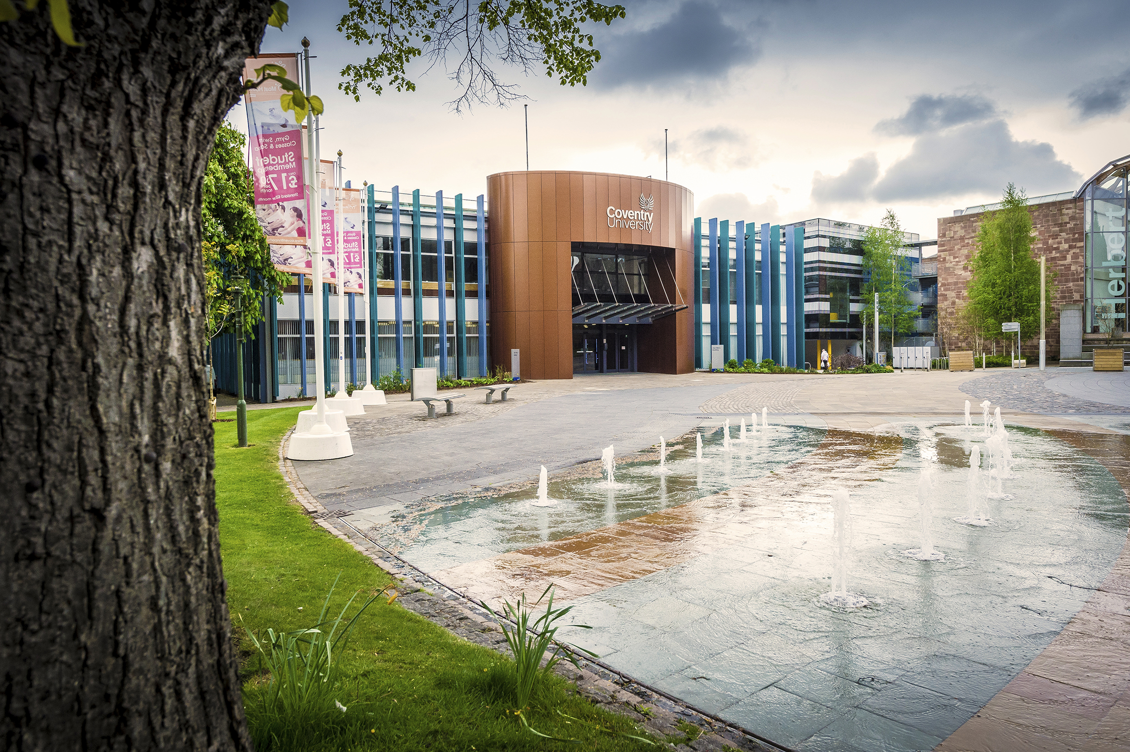
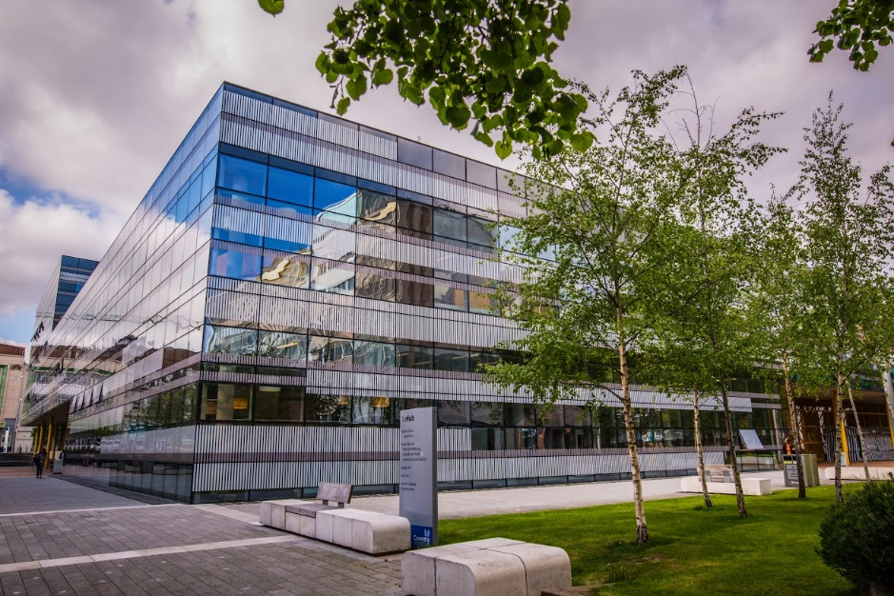
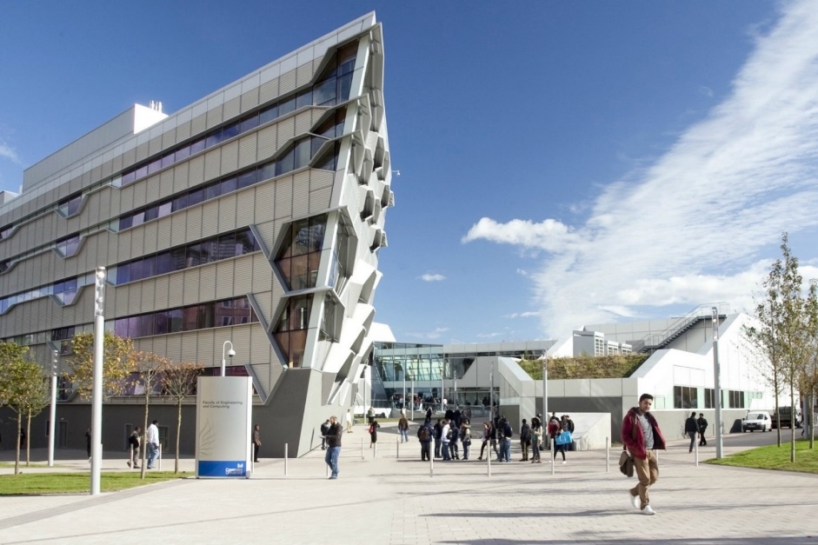
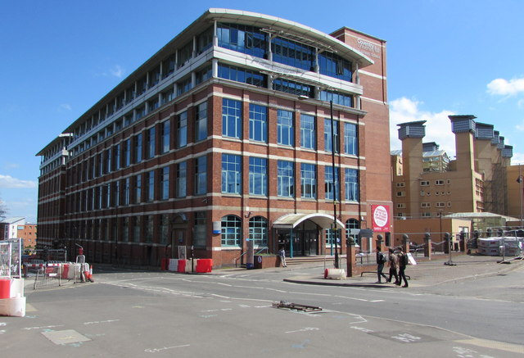
Alan Berry Building
The Hub
Engineering and Computing Building
William Morris Building

Slide 9
Surrounding Areas
If for the day you wanted to venture out of Coventry to see what's on offer in the surrounding areas, you will be pleased to know that being in the middle of England gives you the perfect opportunity to have a day out at a variety of areas each with their own unique touch only a short bus or train ride away.
Firstly we have the town of Royal Leamington Spa located south of Coventry. This beautifully designed town offers a range of bars and restaurants that can cater to any taste and has some of the most eloquent scenic walks in the Midlands.
Next is the county of Warwickshire which boasts an impressive castle, preserved in its history and given new life by modern jousting re-enactments and a live dudgeon tour by a team of dedicated actors.
If you are more into the arts then the town of Stratford-Upon-Avon (Shakespeare's Town) is the place for you. With the whole town centre build upon the Shakespearean legacy as well as an impressive canal and theatre where many of the now famous plays are performed to sell out crowds.
Finally sitting next to Coventry is the even larger Birmingham, only a 20 minuet train journey will take out to this lively and cultured city. With its array of shops, bars and restaurants and leisure activities, Birmingham promises to have something for everyone.

Slide 10
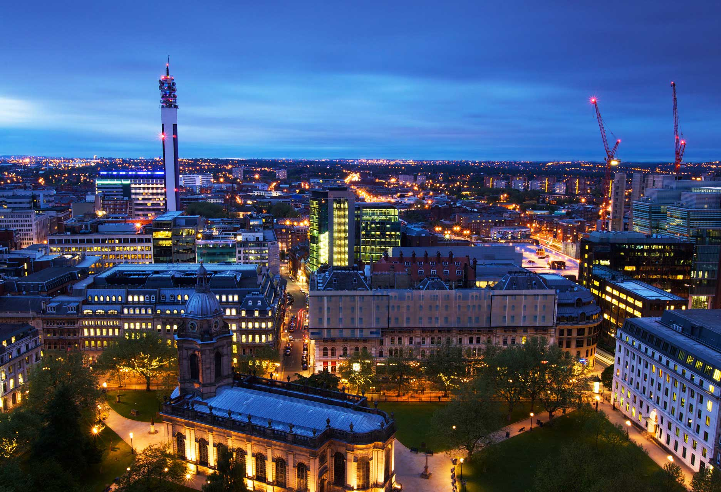
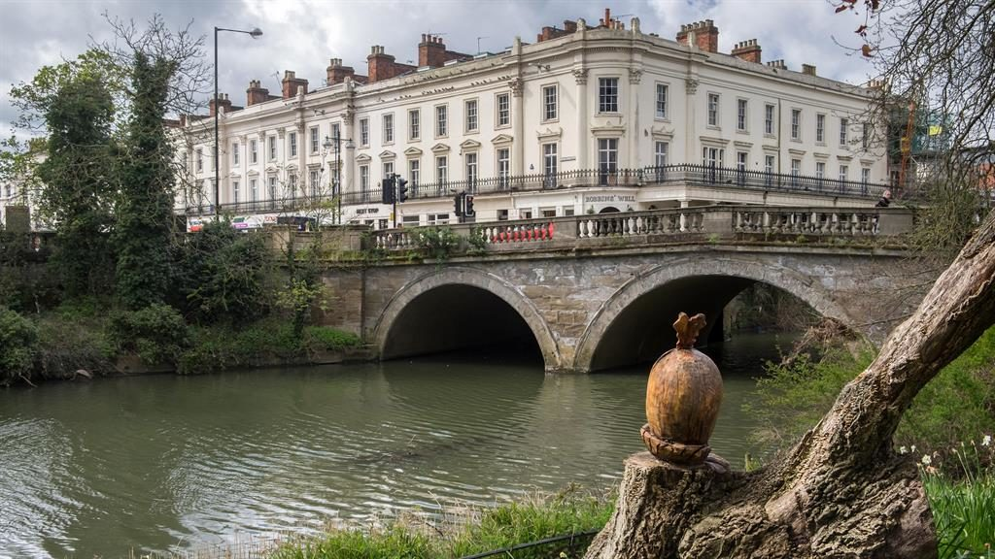
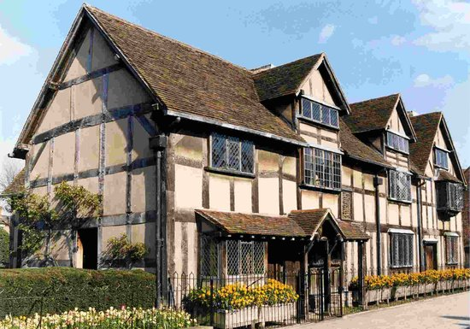
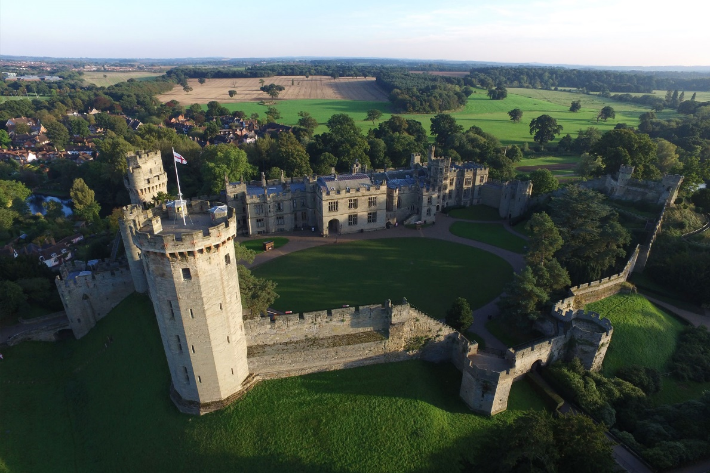
Birmingham
Royal Leamington Spa
Shakespeare’s House Stratford
Warwick Castle

Slide 11
Coventry
Birmingham
Royal Leamington Spa
Warwick Castle
Stratford-Upon-Avon

